Slide 1
AP Computer
Science Principles
Python
Unit 5: Data Structures
Lab 1: Tuples (day 2)
2-27-23
Class 097

Slide 2
Do Now!
Use the U5L1 Tuples Replit project to write some code to do the following:
Create a tuple named things with 3 elements:
the first element is your favorite number (an integer)
the second is the name of your favorite color (a string)
the third is a boolean value: True if you had a good break, False if you didn't
2. Choose one of the 3 elements at random and print it out.
Run your code a few times to make sure the random part works!

Slide 3
Do Now! one way to do it
import random
things = (7, "orange", True)
choice = random.randint(0, 2)
print(things[choice])

Slide 4
Coming Up
This week: Data structures & Pygame intro
Friday, March 3, 5:00pm: Create Task DRAFTS must be uploaded
Next week: Pygame projects!
MAY 1, 11:59 PM: FINALIZE CREATE TASK!
Through May 8: Rest of AP CSP curriculum, AP Exam Prep
Monday, May 8, 12:00pm: AP Exam
2 hours total: 70 MC
Post-AP: Interfaces, GUIs, web APIs, final project

Slide 5
Agenda
Unit 5 Lab 1: Tuples (second attempt!)
Originally this was going to be skipped and ungraded, but Mr. Miller didn't want you to miss the opportunity to work with tuples, so we will spend an extra day (today) on the lab
Due tomorrow
U5L1 Optional Extension (+10 EC, due 3/6)

Slide 6
AP Computer
Science Principles
Python
Unit 5: Data Structures
Lab 1: Tuples
Create Task is Done!
2-16-23
Class 096

Slide 7
Coming Up
Today and week we return: Data structures & Pygame intro
Friday, March 3: final day for Create Task DRAFTS to be uploaded
Week of March 6: Pygame projects!
MAY 1, 11:59 PM: CREATE TASK FINALIZE!
Up through May 8: Rest of AP CSP curriculum, AP Exam Prep
Monday, May 8, 12:00pm: AP Exam
2 hours total: 70 MC
Post-AP: Interfaces, GUIs, web APIs, final project + presentation

Slide 8
Tuples
There are two accepted pronunciations for tuple:
"tupple", rhymes with supple
"toople", rhymes with the ruple in quadruple
While you will hear both, the first pronunciation is probably most common.

Slide 9
Tuple
Similar to a list, a tuple is another data structure that allows you to store multiple values in a single variable, and a tuple can have as many elements as you want (although in practice tuples usually only have a few elements).

Slide 10
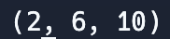
Tuple
Similar to a list, a tuple is another data structure that allows you to store multiple values in a single variable, and a tuple can have as many elements as you want (although in practice tuples usually only have a few elements).
In Python, you create a tuple similar to creating a list, but using parentheses instead of square brackets: my_tuple = (2, 6, 10)
This looks a lot like creating a list: my_list = [2, 6, 10]
Let's print the tuple: print(my_tuple)

Slide 11
Tuple
Also like a list, a tuple is an ordered set of elements, where an element is a single value in the tuple, and you can access each element by using index notation, just like a list:
Printing the first element in my_tuple: print(my_tuple[0])
Same as printing the first element in my_list: print(my_list[0])
Printing the third element in my_tuple: print(my_tuple[2])
Same as printing the third element in my_list: print(my_list[2])

Slide 12
Tuple
So far, tuples and lists seem a lot alike… so how are they different?

Slide 13
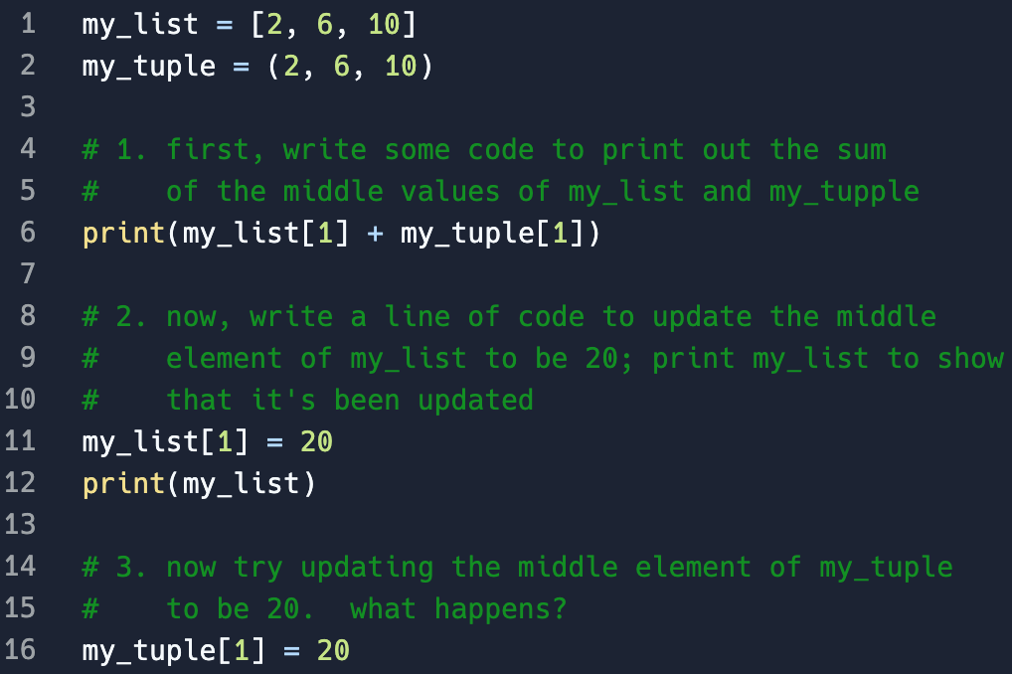
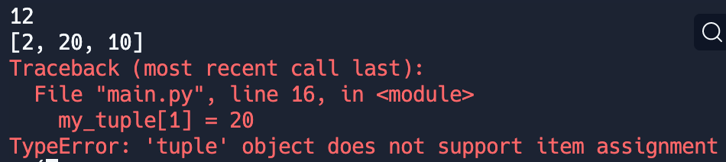
Tuple

Slide 14
Tuple

Slide 15
Tuple

Slide 16
Tuple
Unlike lists, you cannot change/modify an element in a tuple once the tuple has been created! (lists you can, tuples you can't)

Slide 17
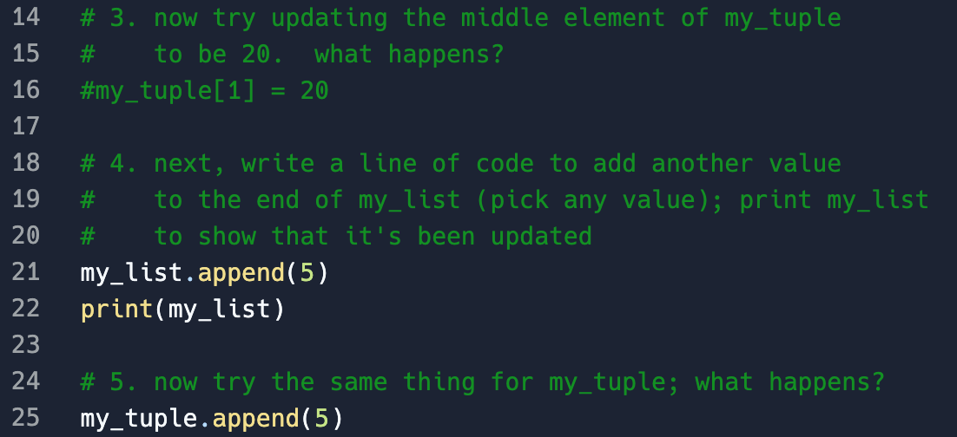
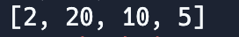
Tuple

Slide 18
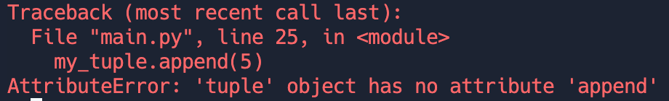
Tuple

Slide 19
Tuple
Unlike lists, you cannot add (or remove) elements to a tuple once the tuple has been created! (lists you can, tuples you can't)

Slide 20
Partner Discussion!
So why do you think you would ever want to use a tuple instead of list? Why do tuples even exist? Are there any advantages?

Slide 21
Partner Discussion!
So why do you think you would ever want to use a tuple instead of list? Why do tuples even exist? Are there any advantages?
It turns out, tuples are more memory efficient than lists, so if you know the data in a collection doesn't need to change or isn't going to change, using a tuple over a list is preferred (although you could use either).
If you know that data in the collection needs the ability to be modified, like updating/adding/removing, using a list is the only option (since a tuple doesn't support modification).
There is no situation in where a tuple must be used, it's just a more efficient data structure option when data won't be modified.

Slide 22
DEMO: Tuples can be used as function parameters (and can be iterated over like lists)
def add_nums(nums):
sum = 0
for num in nums: # you can iterate over a tuple like a list
sum = sum + num
return sum
# main program
my_nums = (3, 5, 10, 8)
the_sum = add_nums(my_nums) # the tuple is passed as a parameter
print(the_sum)

Slide 23
DEMO: Tuples can be returned by functions
import random
def random_coord():
x = random.randint(-100, 100)
y = random.randint(-100, 100)
coord = (x, y) # create tuple from x and y
return coord # return tuple
# main program
new_coord = random_coord()
print(new_coord)
new_coord = random_coord()
print(new_coord)
new_coord = random_coord()
print(new_coord)

Slide 24
DEMO: Tuples can be returned by functions
import random
def random_coord():
x = random.randint(-100, 100)
y = random.randint(-100, 100)
coord = [x, y] # COULD have used a list here
return coord # return list
# main program
new_coord = random_coord()
print(new_coord)
new_coord = random_coord()
print(new_coord)
new_coord = random_coord()
print(new_coord)
Note that we could have also returned a list with 2 elements in it, rather than a tuple. But since my program doesn't intend to change the x or y in the returned points, we use a tuple because it's more efficient!

Slide 25
Agenda
Unit 5 Lab 1

